Slide 2
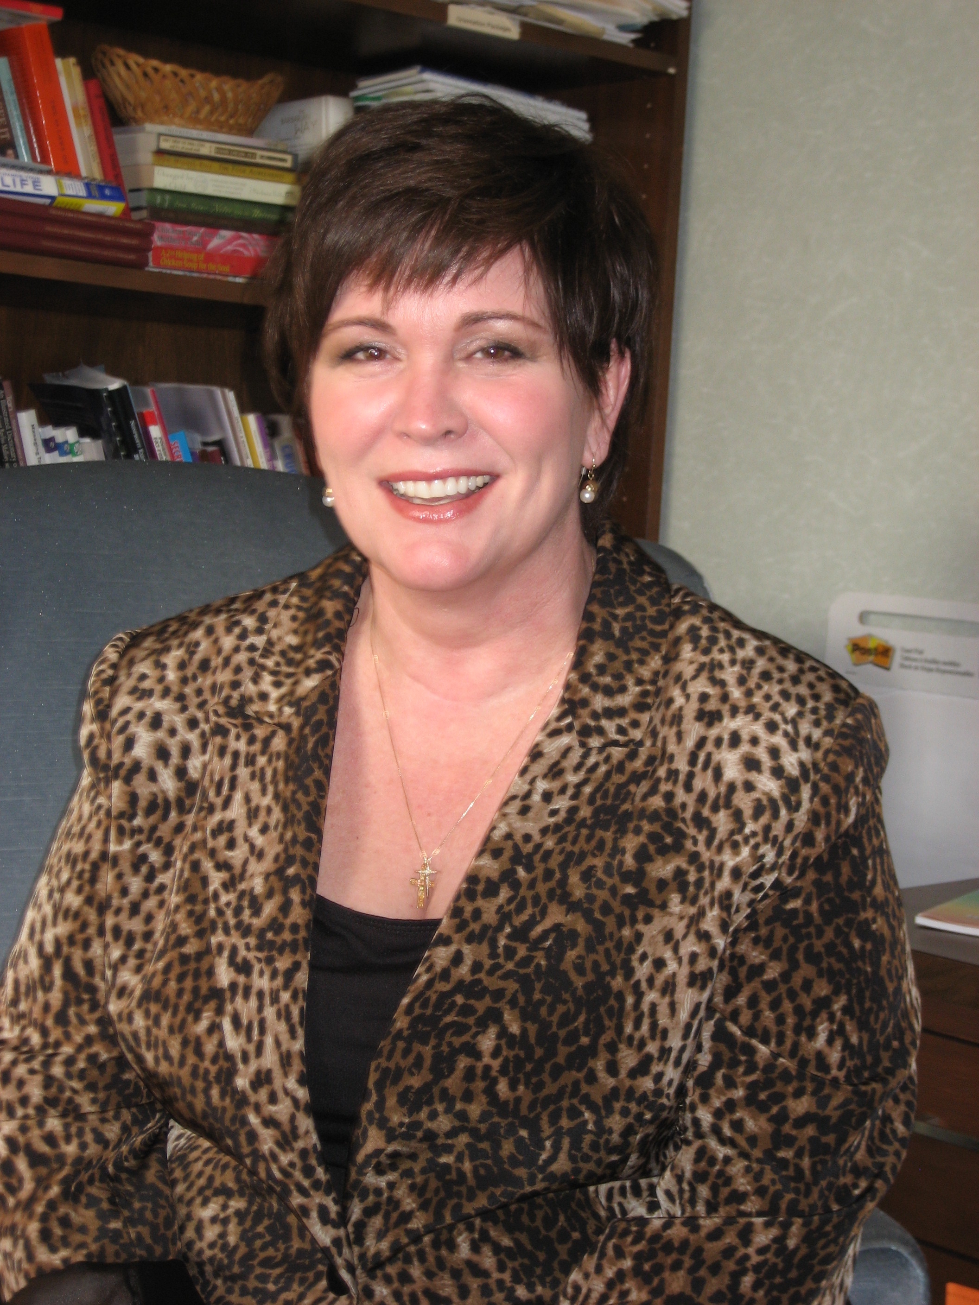
Presenter Bio
Karen L. Ball, President and CEO currently leads the Foundation in forging new inroads for patient engagement and research. As a past recipient of the Betty Ford Award, she continues to be nationally recognized for her tenacity and vision. Karen is an editor, author, leader and a 32 plus year advocate in Patient Advocacy. Karen has co-authored textbooks on Sturge-Weber as well as contributed a multitude of articles on subjects on Patient Advocacy. Board participation: March of Dimes Colorado, served on the National Organization for Rare Disorders (NORD) Board for 10 years; serves on the American Brain Coalition Board of Directors(ABC); Served as the Vice Chair of Rare New Jersey. She is a former teacher and Up With People alumni. Karen has two inspiring children with SWS and autism.

Slide 3
Presenter Bio

Slide 4
Overview and Food for Thought
-The first rendition of “the plan” came into being back in 1990. The SWF wrote up a Medical Records Binder..yes LITERALLY a 3 ring binder to track seizures, ER contacts for caregivers and school…my how times have changed!
-We can do our best to prepare for any and all situations but being human there will be “those” days. Take them in stride!
-This webinar is meant to provide an overview of plan items that have been utilized by parents before you. Think of it as food for thought!

Slide 5
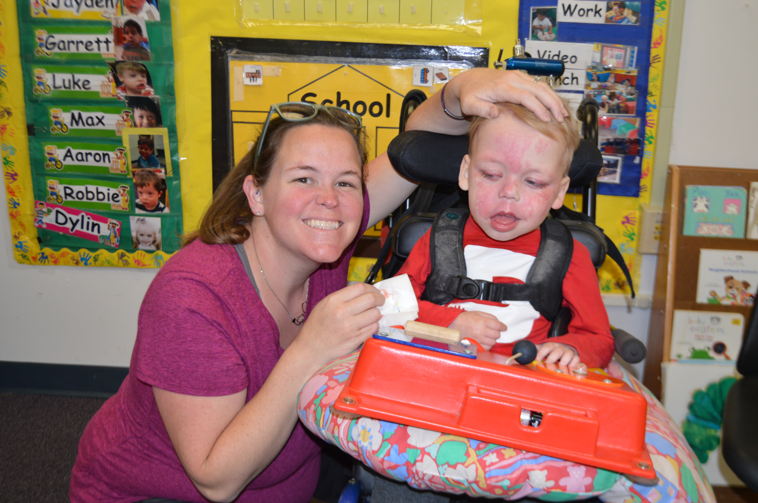
What to Include in Your Plan
After the Diagnosis:
Natural Supports
Health Care Team
Community Supports
Medical Plan:
Home Plan
School/Daycare/Camp/Sleepovers
Travel
Devices/Advice/Support:
Wearable devices and alerts
Medical Power of Attorney

Slide 6
AFTER THE DIAGNOSIS
You will need, if you haven’t already begun that is, to assemble your A Team and Plan. For many of us, our first instinct is to reach out to our families and friends…great start!
In really fast order, your healthcare providers and local community support groups and organizations will begin to be key members of your team.
We can’t stress this enough…self care is of utmost importance! Whatever you did before the diagnosis…continue as long as it was and is healthy for you.
3 days! Yep…for more than 20 years Karen has lived by the 3 day rule: one day to wallow and worry-one day to brainstorm solutions-one day and more to get that plan in action to rescue the situation and yourself! If you complain, you remain ☺

Slide 7
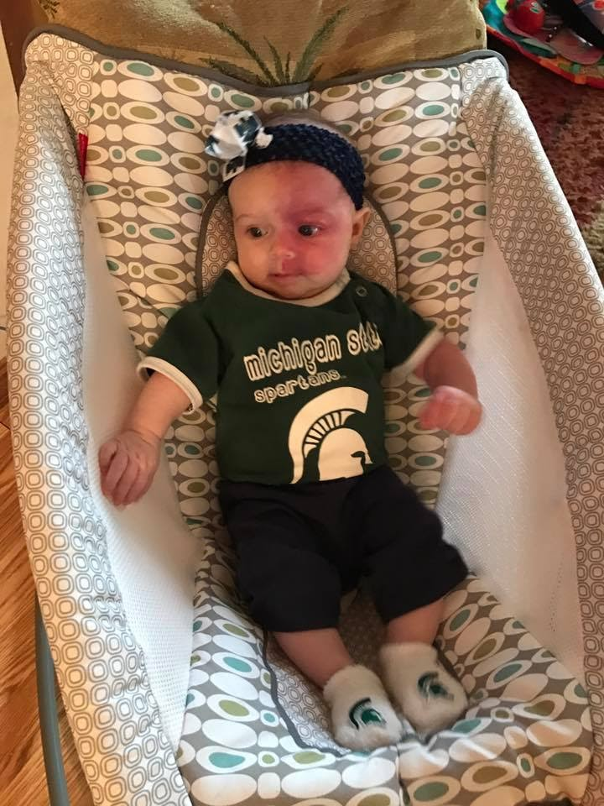
Natural Supports
It’s important to have support for those times when you can’t be the “lead dog” and to plan for the coming years ahead when you will no longer be living. Here are a few that come to mind:
Immediate family members
Family near local treating hospital or SWF Clinical Care Network
Back up family for acute crisis
Local Friends-emotional support for self and siblings
Church or Synagogue Care Teams

Slide 8
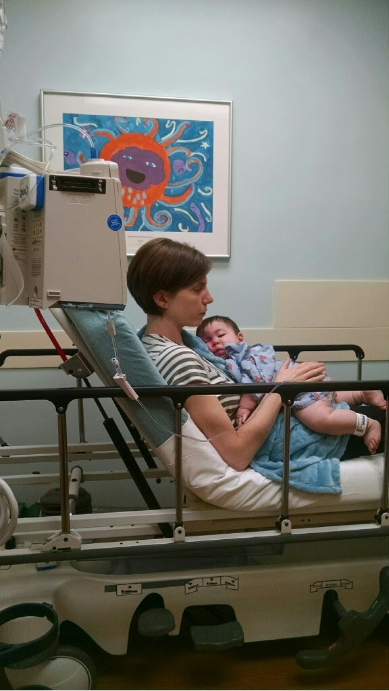
Healthcare Team: For a reason, a season or a lifetime!
It’s also important to have a healthcare team in place and good communication to keep them all up to date! Some parents choose
one medical professional to keep the others up to date and some
choose to fill that role themselves. Here are a few providers we suggest:
Pediatrician Pain Management Team
Dermatologist
Endocrinologist
Neurologist
Ophthalmologist/Glaucoma Specialist
Physical/Occupational Therapist
Cognitive Behavioral Therapist
Family Psychotherapist
Nutritionist

Slide 9
Community Supports
Local and National organizations and online forums can bring the world of support right into your own home 24-7. Be a discerning medical and emotional support consumer! Each case of SWS is unique and this is a marathon NOT a sprint. Here are a few we suggest:
The Sturge-Weber Foundation-website, online forums, 1-1 support/resources and 25 Clinical Care Network of diverse providers
Epilepsy Foundation-website, online forums and diverse resources
National Federation of Families for Children’s Mental Health
Children’s Eye Foundation
Department of Developmental Services
Birth to Three
Board of Education

Slide 10
THE MEDICAL PLAN
This part of “the plan” is most important and will be ever changing over the years. We recommend reviewing it and sharing with your team at least once a year.
Home plan for seizures or strokes plan
School/Daycare/Camp/Work plan
Travel plan
Advice

Slide 11
Home Plan
Home plan for seizures or strokes:
Do you have Emergency seizure medications for long seizures? Where are they located and dosage due?
Is there a directive for others to find and administer it?
Do you have bottles labeled with times to administer glaucoma meds or seizure meds?
Do you have an Babysitter/EMS binder with medical/SWS information?
Do you have a “go bag” with personal care items for a hospital stay?
Do you have telephone and contact numbers on hand to call and care for other children to be left at home?

Slide 12
School/Daycare/Camp/Sleepovers/Work
Each situation brings similar worries for an individual but are unique and need your attention to ensure smooth transition in times of surprise events!
What’s the plan if there is a seizure or stroke?
Do you keep medications to treat event or call 911?
Do you have your EMS up to date binder or sheet for responders?

Slide 13
Travel
In the early days and years, the thought of travel beyond your local community can be scary for some people. Believe it or not you will thrive and survive so exhale and and live in joy as best you can!
Do you have a plan that travels with you either paper or electronically that others can immediately access?
USB drives or QR scannable codes linking them to medical information?
Do you carry extra medication and regular items like aspirin, Benadryl, baby wipes, etc?
Do you have travel insurance on airline flights?
Do you have the contact numbers for local hospitals, Clinical Care Networks and a designated family or friend to handle communication so you can focus on the event?

Slide 14
Devices/Advice/Support
Today and well into the future there are some wonderful devices and resources at you fingertips to provide peace of mind and ease your daily living.
The devices come in the form of bracelets, necklaces, shoe lace tags which can house medical alerts and contact information. If you or your child has a mobile telephone, set your alerts as appropriate.
Advice is accessible ANYWHERE! Some is free and some costly…take all with a grain of salt and remember your case of SWS is as unique as you and your family (and values).
Seek legal and medical support early and review often. Get a medical power of attorney for your child before they turn 18 even if they don’t need guardianship.

Slide 15
With all that said…
As Karen well knows, “the years tell us much that the days never knew”!
Focus on the moment, cherish each other for your unique contributions to your family, friends, community and world. Remember the 3 day rule!
The time WILL fly and you’ll look back on your life with SWS in wonder of all that was survived, conquered, and celebrated.
Having a plan whether for your child with SWS or yourself is always a good thing!
Thank you and we look forward to your questions and your comments on the downloadable deliverables from this webinar on the website link www.sturge-weber.org/$$##$%^!

Slide 16
If you haven’t already submitted your question by email, you can submit one now using the questions function in your control panel.
We’ll do our best to answer as many questions as possible.
Please bear with us if we are unable to get to your question due to time or topic constraints. Though we are unable to provide individual medical advice, we can point you towards valuable resources and information to help you and your loved ones make informed decisions.
Questions & Answers

Slide 17
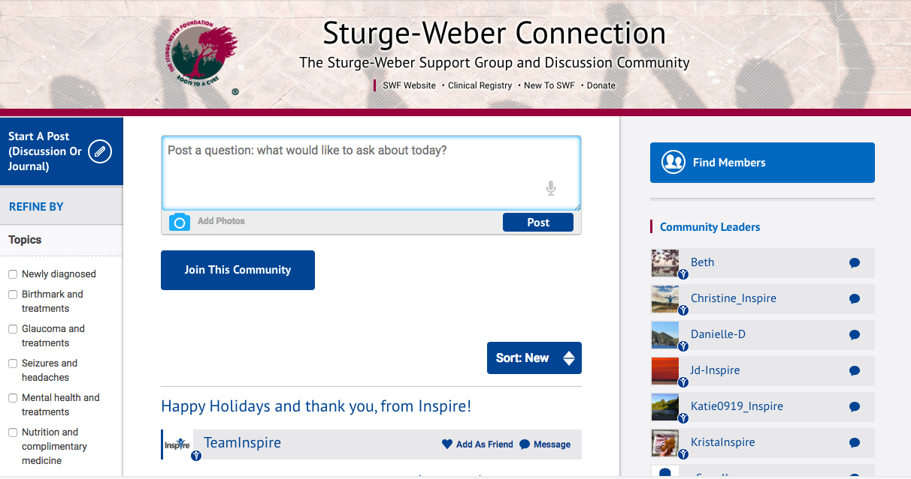
Thank You for Your Participation
Continue the conversation following today’s webinar by going to the
Sturge-Weber Connection community at SWF.inspire.com
Please send questions or comments to us at Partner@inspire.com!

